Slide 1
SCS1302 Internet Programming
Unit 2 JavaScript
Ms.J.S.Vimali

Slide 2
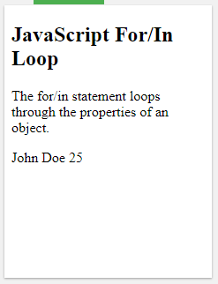
For/In Loop
<!DOCTYPE html>
<html>
<body>
<h2>JavaScript For/In Loop</h2>
<p>The for/in statement loops through the properties of an object.</p>
<p id="demo"></p>
<script>
var txt = "";
var person = {fname:"John", lname:"Doe", age:25};
var x;
for (x in person) {
txt += person[x] + " ";
}
document.getElementById("demo").innerHTML= txt;
</script>
</body>
</html>

Slide 3
The For/Of Loop
The JavaScript for/of statement loops through the values of an iterable objects for/of lets you loop over data structures that are iterable such as Arrays, Strings, Maps, NodeLists, and more.
The for/of loop has the following syntax:
for (variable of iterable){
// code block to be executed
}
variable - For every iteration the value of the next property is assigned to the variable. Variable can be declared with const, let, or var.
iterable - An object that has iterable properties.

Slide 4
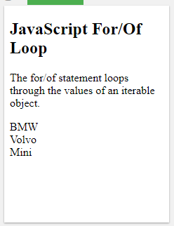
<!DOCTYPE html>
<html>
<body>
<h2>JavaScript For/Of Loop</h2>
<p>The for/of statement loops through the values of an iterable object.</p>
<script> var cars = ['BMW', 'Volvo', 'Mini']; var x; for (x of cars) { document.write(x + "<br >");
}
</script>
</body>
</html>
Looping over an Array
Output

Slide 5
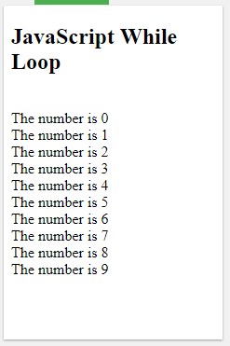
The While Loop
The while loop loops through a block of code as long as a specified condition is true.
Syntax
while (condition) {
// code block to be executed
}
<!DOCTYPE html>
<html>
<body>
<h2>JavaScript While Loop</h2>
<p id="demo"></p>
<script>
var text = "";
var i = 0;
while (i < 10) {
text += "<br>The number is " + i;
i++;
}
document.getElementById("demo").innerHTML = text;
</script></body></html>
Output

Slide 6
The Do/While Loop
The do/while loop is a variant of the while loop. This loop will execute the code block once, before checking if the condition is true, then it will repeat the loop as long as the condition is true.
Syntax
do {
// code block to be executed
}
while (condition);
Example
The example below uses a do/while loop. The loop will always be executed at least once, even if the condition is false, because the code block is executed before the condition is tested:

Slide 7
<!DOCTYPE html>
<html>
<body>
<h2>JavaScript Do/While Loop</h2>
<p id="demo"></p>
<script>
var text = ""
var i = 0;
do {
text += "<br>The number is " + i;
i++;
}
while (i < 10);
document.getElementById("demo").innerHTML = text;
</script>
</body>
</html>
Output

Slide 8
JavaScript Form Validation
HTML form validation can be done by JavaScript.
If a form field (fname) is empty, this function alerts a message, and returns false, to prevent the form from being submitted:
function validateForm()
{
var x = document.forms["myForm"]["fname"].value;
if (x == "")
{
alert("Name must be filled out");
return false;
}
}
The function can be called when the form is submitted:

Slide 9
<!DOCTYPE html>
<html>
<head>
<script>
function validateForm() {
var x = document.forms["myForm"]["fname"].value;
if (x == "") {
alert("Name must be filled out");
return false;
}
}
</script>
</head>
<body>
<form name="myForm" action="/action_page.php" onsubmit="return validateForm()" method="post">
Name: <input type="text" name="fname">
<input type="submit" value="Submit">
</form>
</body>
</html>

Slide 10
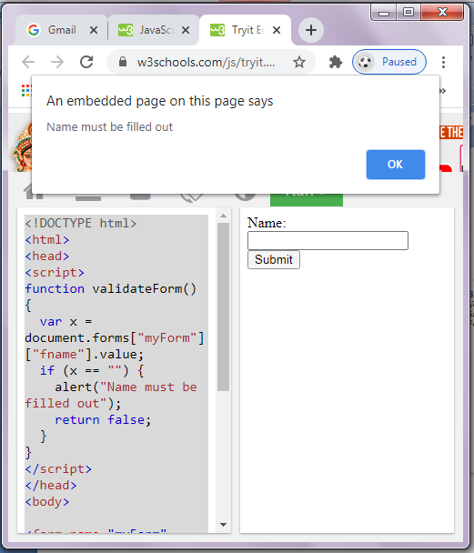
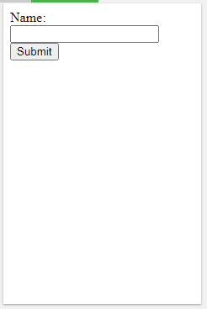
Output
Output

Slide 11
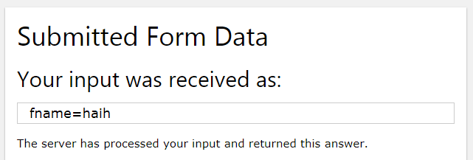
Output

Slide 12
<!DOCTYPE html>
<html>
<body>
<h2>JavaScript Can Validate Input</h2>
<p>Please input a number between 1 and 10:</p>
<input id="numb">
<button type="button" onclick="myFunction()">Submit</button>
<p id="demo"></p>
<script>
function myFunction() {
var x, text;
// Get the value of the input field with id="numb"
x = document.getElementById("numb").value;
// If x is Not a Number or less than one or greater than 10
if (isNaN(x) || x < 1 || x > 10) {
text = "Input not valid";
} else {
text = "Input OK";}
document.getElementById("demo").innerHTML = text;}
</script></body></html>

Slide 13
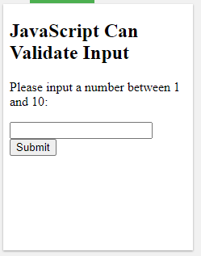
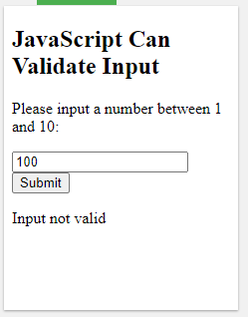
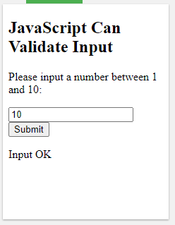

Slide 14
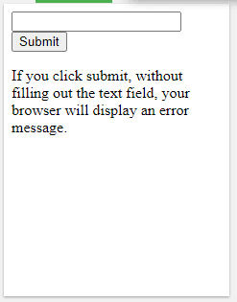
<!DOCTYPE html>
<html>
<body>
<form action="/action_page.php" method="post">
<input type="text" name="fname" required>
<input type="submit" value="Submit">
</form>
<p>If you click submit, without filling out the text field,
your browser will display an error message.</p>
</body>
</html>
Output

Slide 15
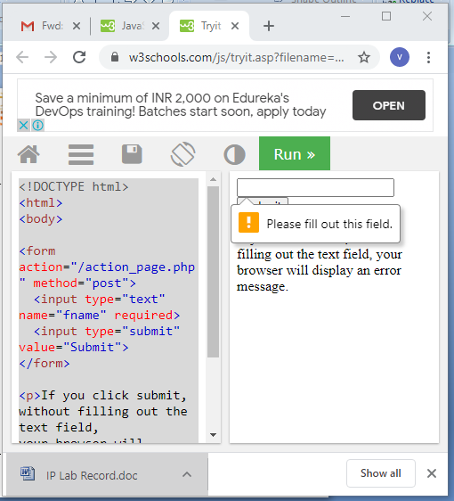
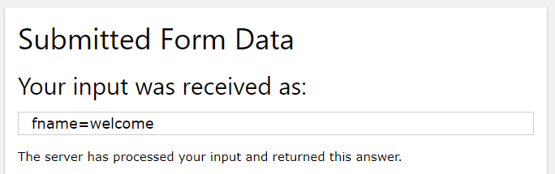
Output
Output

Slide 16
<html>
<head><title>Form validation</title>
<body bgcolor="gray" >
<h1><b><u> User profile </u></b></h1>
<form name="form1" method="get">
<b>
Name:&nbsp;&nbsp<input type=“text”name=“name” maxlen=“15”><br>
E-mail:&nbsp<input type="text" name="email" onfocus="fun1()"><br>
Age:&nbsp;&nbsp;&nbsp<input type="text" name="age" onfocus="fun2()"><br>
Address:&nbsp;&nbsp;<textarea onfocus="fun3()" rows=10 cols=20
name="addrs"></textarea><br>
Phoneno:&nbsp;&nbsp;<input type="text" name="phno" onfocus="fun4() "><br>

Slide 17
Bank Name:<br>
<input type="radio" onfocus="fun5()" name="bank" value="Indian Bank">Indian Bank
<input type="radio" onfocus="fun5()" name="bank" value="Indian Overseas Bank">Indian
Overseas Bank <br>
<input type="radio" onfocus="fun5()" name="bank"value="ICICI">ICICI
<input type="radio" onfocus="fun5()" name="bank" value="Axis">Axis <br>
Card No:&nbsp;&nbsp;<input type="text" name="card" onfocus="fun6()"><br>
Pin No:&nbsp;&nbsp<input type="password" name="pin" onfocus="fun7()"><br><br><br><br>

Slide 18
<input type="button" value="submit" onfocus="fun8()" onclick="fun9()">
<input type="reset" value=clear>
</b>
</form>
</body>
</html>

Slide 19
<script language="javascript">
var s1,s2,s3,s4,s5,s6,s7,s8;
function fun1(){
if(form1.name.value=="")
{
alert("enter the name");
form1.name.focus();}
else{
var l=form1.name.value.length;
s1=new String(form1.name.value);
for(i=0;i<l;i++) {
if(!((s1.charAt(i)>='a'||s1.charAt(i)>='A') && (s1.charAt(i)<='z'||s1.charAt(i)<='Z'))){
alert("Please enter the correct name");
form1.name.focus();
break;
}}}
}

Slide 20
function fun2(){
if(form1.email.value==""){
alert("enter the email");
form1.email.focus();}
else{
var c1=0;
var c2=0;
var l=form1.email.value.length;
s2=new String(form1.email.value);
for(i=0;i<=l;i++){
if(s2.charAt(i)=='@'){
c1=c1+1;
var j=i;}}
if(c1==1){
for(i=j;i<=l;i++){
if(s2.charAt(i)=='.')
c2=c2+1;} }
if(!((c1==1) && (c2==1))){
alert("enter the correct e-mail id");
form1.email.focus();}}}

Slide 21
function fun3()
{
s3=form1.age.value;
if((s3=="")||isNaN(s3)) //isNaN() function determines whether a value is an illegal number
{
alert("enter the age");
form1.age.focus();
}
}
function fun4()
{
s4=form1.addrs.value;
if(s4=="")
{
alert("enter the address");
form1.addrs.focus();
}
}

Slide 22
function fun5()
{
s5=form1.phno.value;
l=form1.phno.value.length;
if((s5=="") || isNaN(s5)|| l!=10)
{
alert("Invalid phone number");
form1.phno.focus();
}
}

Slide 23
function fun6()
{
var tag1=0;
for(var i=0;i<form1.bank.length;i++)
{
if (form1.bank[i].checked==true)
{
s6=form1.bank[i].value;
tag1=1;
}
}
if(!(tag1==1))
{
alert("select ur Bank");
}
}

Slide 24

function fun7()
{
s7=form1.card.value;
if((s7=="") || isNaN(s7))
{
alert("Invalid card number");
form1.card.focus();
}
}
function fun8()
{
s8=form1.pin.value;
var l=form1.pin.value.length;
if(((s8=="") || isNaN(s8))&&(l==3))
{
alert("Invalid card number");
form1.pin.focus();
}
}

Slide 25
function fun9(){
w1=window.open('Order Conformation.html');
w1.document.writeln("<h1><center>");
w1.document.writeln("Order Conformation Details");
w1.document.writeln("</h1></center>");
w1.document.writeln("<br>");
w1.document.writeln("Name:",s1);
w1.document.writeln("<br>");
w1.document.writeln("Email:",s2);
w1.document.writeln("<br>");
w1.document.writeln("age:",s3);
w1.document.writeln("<br>");
w1.document.writeln("Address:",s4);
w1.document.writeln("<br>");
w1.document.writeln("Phone:",s5);
w1.document.writeln("<br>");
w1.document.writeln("Bank Name:",s6);
w1.document.writeln("<br>");
w1.document.writeln("Card Number:",s7);
w1.document.writeln("<br>");} </script></head>

